Slide 1
Recommendation Week 4

Slide 2
Administrivia
Adds+Drops: will adjust presentation/scribe schedule tonight
Let me know if you are NOT ok with being moved
Presentations: send slides to yiru
Website: reviews, slides, announcements

Slide 3
Administrivia
A1 grading released tomorrow
Feedback on assignments?

Slide 4
Administrivia
Project Proposal due tonight: follow format of the prospectus
What is the problem
Why is it important
Why is it hard
What is your key idea or approach
Any initial results already shown
If not, provide a sketch of idea/algorithm
If not, provide a architecture diagram of the system
The more detailed the better
OK to change idea & add partner between now and related work deadline
https://columbiaviz.github.io/2020s_w6998/projects

Slide 5
Administrivia
Need scribe for Voyager half of class

Slide 6
Draco

Slide 7
Motivation
Choosing a good vis design for a dataset is hard
Factors that determine “good” constantly changing
result of perceptual/usability studies
Way to leverage evolving vis research for auto-visualization?

Slide 8

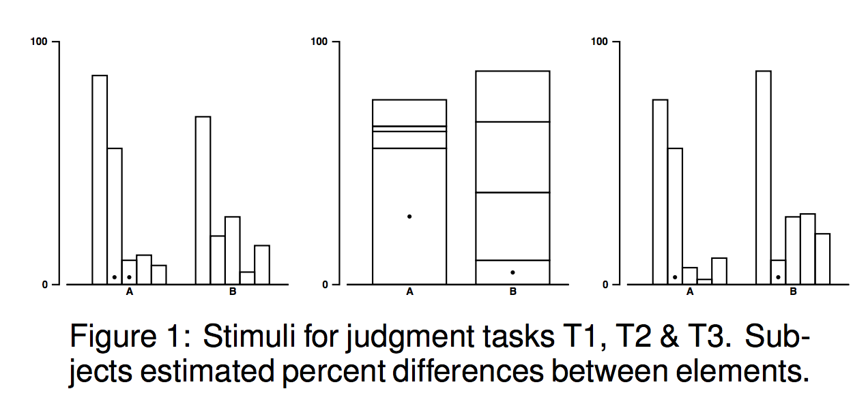
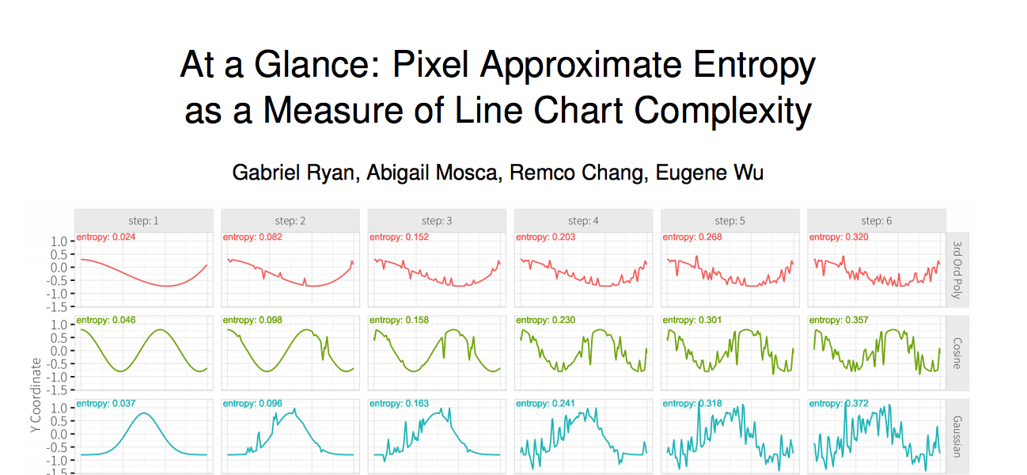
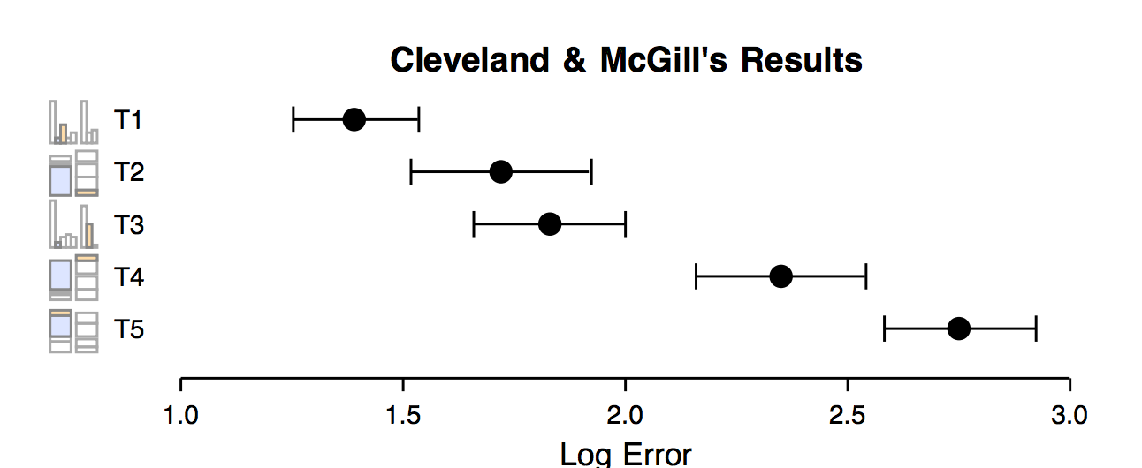
Perceptual Studies

Slide 9
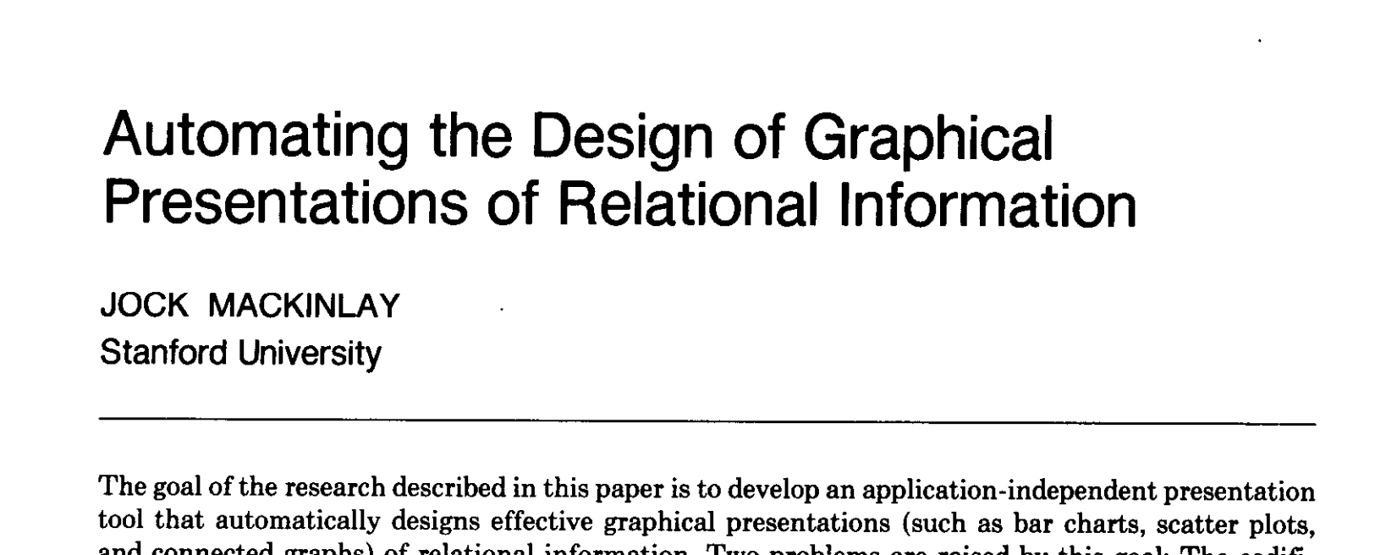
APT

Slide 10
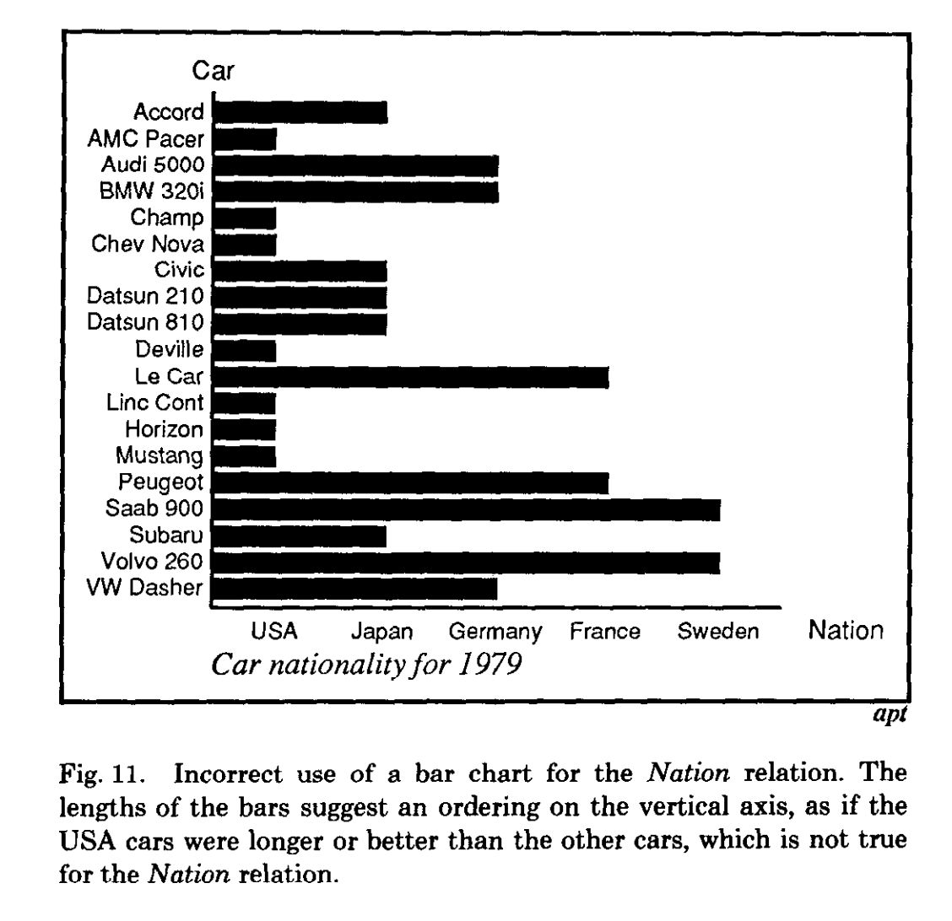
APT
Proposed two criteria for automatically choosing designs
Expressiveness
all facts and only those facts are expressed in the graphical design

Slide 11
APT
Proposed two criteria for automatically choosing designs
Expressiveness
all facts and only those facts are expressed in the graphical design
Effectiveness
user can easily and unambiguously decode the graphical image
Want: most effective design that exactly expresses the data

Slide 12
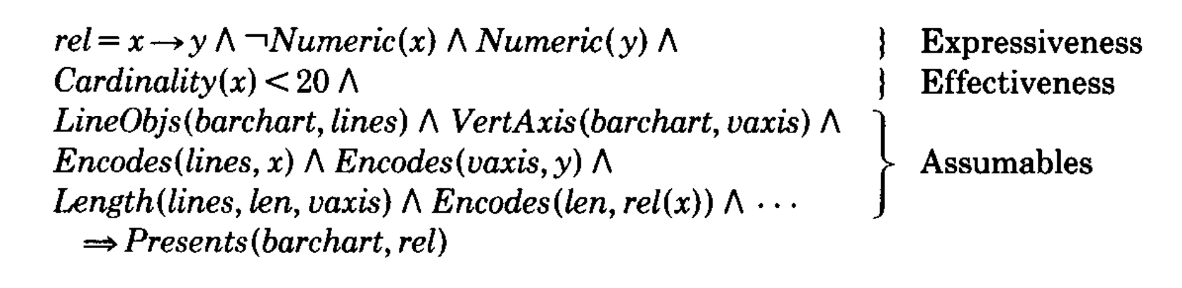
APT
Logic program with hard constraints
Exhaustive search
Bar Chart Rule

Slide 13
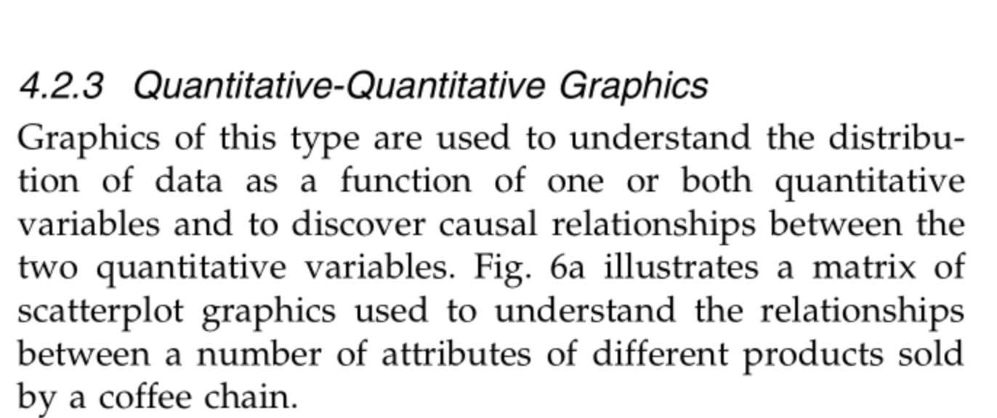
Tableau
Rule-based Heuristics

Slide 14
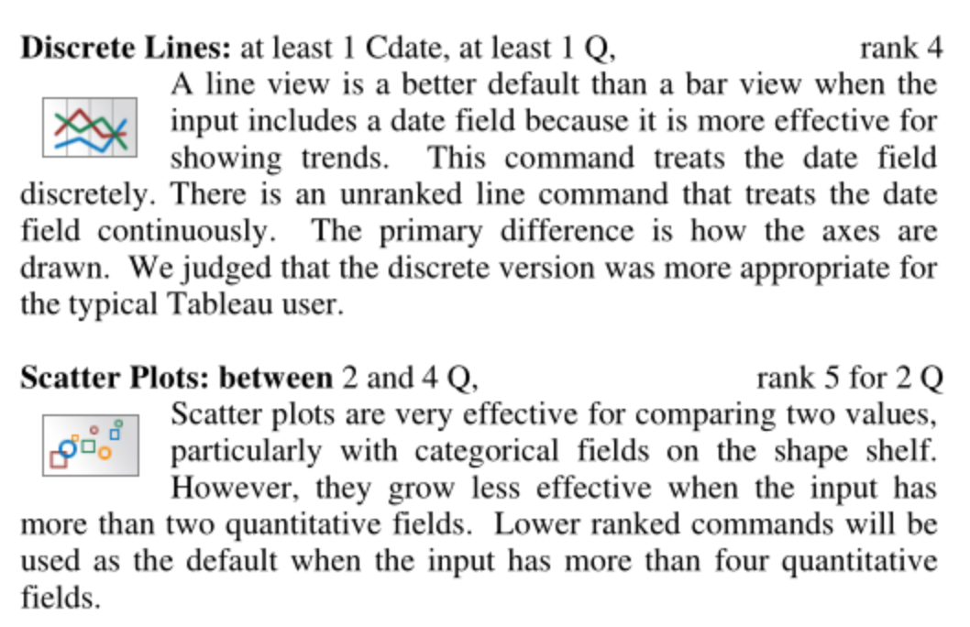
ShowMe
Rule-based heuristics

Slide 15
Voyager
Hard coded heuristics and search procedure

Slide 16
Order of works
APT → Polaris Defaults → ShowMe → Compass/Voyager → Draco

Slide 17
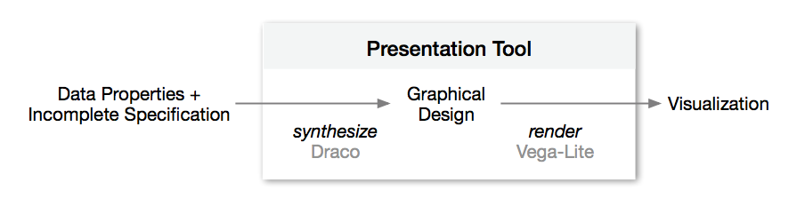
Contributions
Use constraint programming (ASP)
Encode design studies as hard/soft constraints
Perception papers define partial rankings
Learn weight penalties automatically

Slide 18
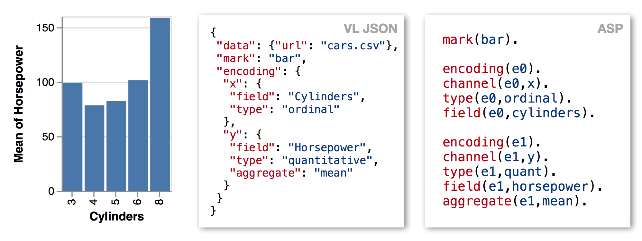
Constraint Language
Search space: vega-lite specs
Hard constraints: incorrect specs
Soft constraints: preferences/ranking
Challenge: encoding vega-lite as ASP statements
expressiveness
effectiveness

Slide 19
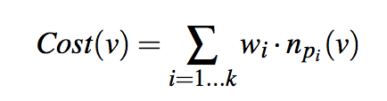
Constraint Language
Atom :- L1, ..., Ln. // Atom is true if L1,...,Ln are true
Atom // Atom is true (like a data row)
:- L1, ..., Ln. // L1,...,Ln evaluates to False
:- L1, ..., Ln. [2] // Penalize result by 2 if violated
Return set of Atoms that obey the rules and minimize penalties
weight
# violations of rule p_{i}

Slide 20
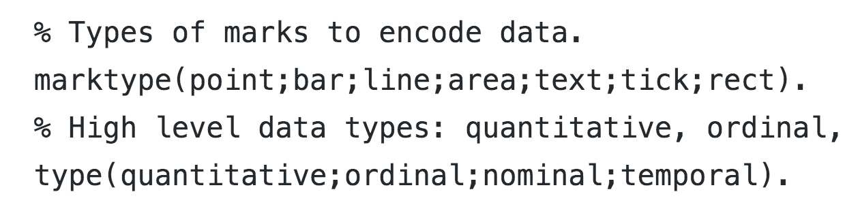
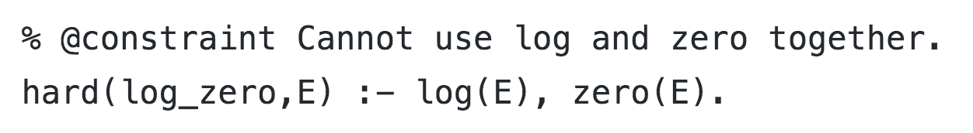
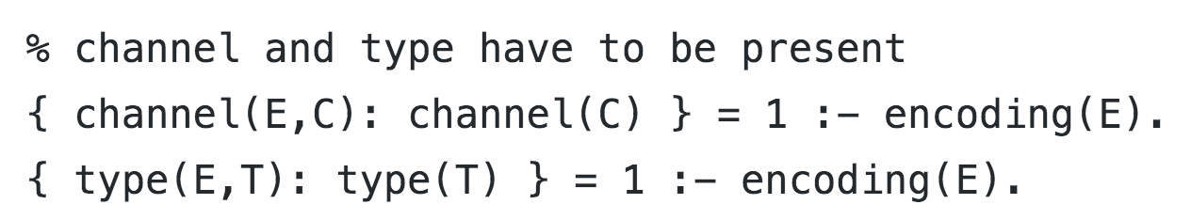
Constraint Language Examples
Define types
Hard Constraints
Encodings require channel and type

Slide 21
Learning Soft Weights
Dozens, hundreds of soft constraints, how to assign weights?
(is hand assignment as hard as heuristics)?
User studies generate pairs of (v₁, v₂) where v₁ preferred over v₂
Use RankSVM to learn what soft constraint weights will most preserve the ranking
Run draco and count # violations of each rule for each vis v_{i}
Rule = feature vector of violation counts
Train SVM to learn weights

Slide 22
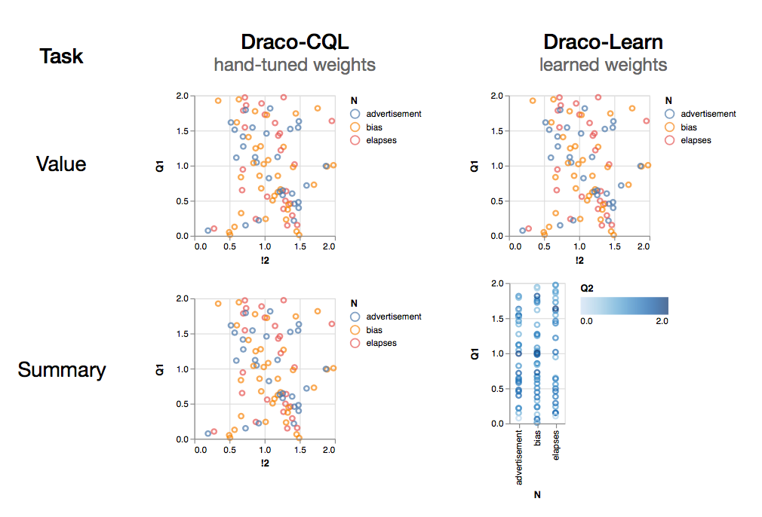
Evaluation/Experiments
Should show
Can express previous systems (APT, Voyager/Compass)
Not embarassingly slow (benefits from fast constraint solver)
Can incorporate new user studies
Weight learning works

Slide 23
Draco Discussion

Slide 24
Draco
What are the killer use cases for a system like Draco?
Data variation, not design variation

Slide 25
Draco
What are the limitations of Draco’s ASP approach?
ASP rules need to flatten the grammar (search space)
Composition of transformations.
Data statistics
Generates static views
Leverage features from rendered output (e.g., overplotting)
More complex/high-level tasks?

Slide 26
Draco

Slide 27
Voyager: Visual Design and Recommendations
Presented by Adam Kravitz

Slide 28
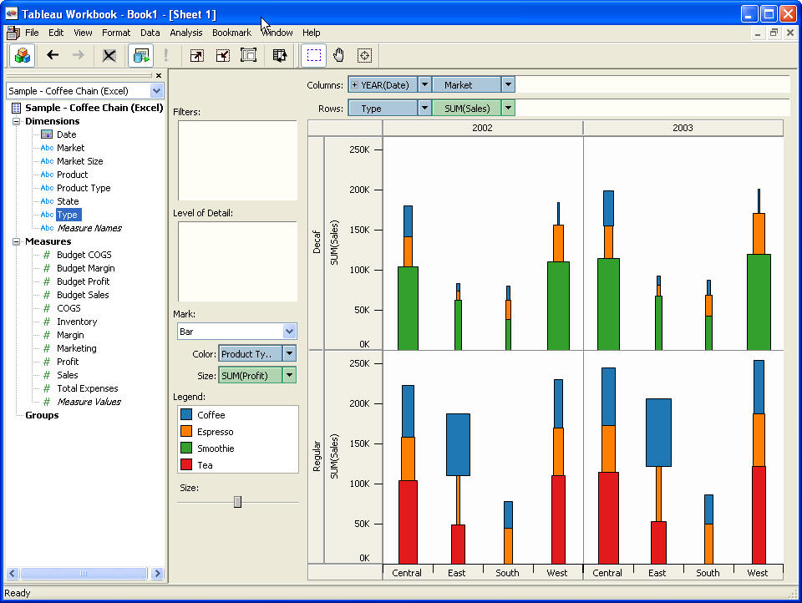
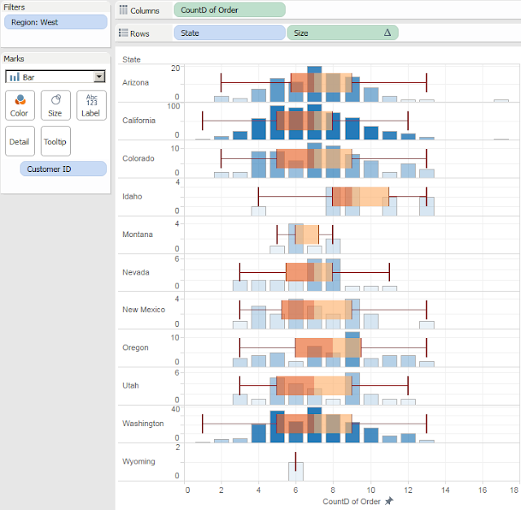
Background
2003 Tableau
Published 2015! (Tableau came out 12 years ago)
Vega-lite
Exploratory Search - ”information retrieval, such as investigating, evaluating, comparing, and synthesizing. Normally used when unsure how to achieve a goal.”
Visual encodings - How data is mapped to visual structures.
Mackinlay APT
http://nb.mit.edu/f/57232
~2015 Tableau

Slide 29
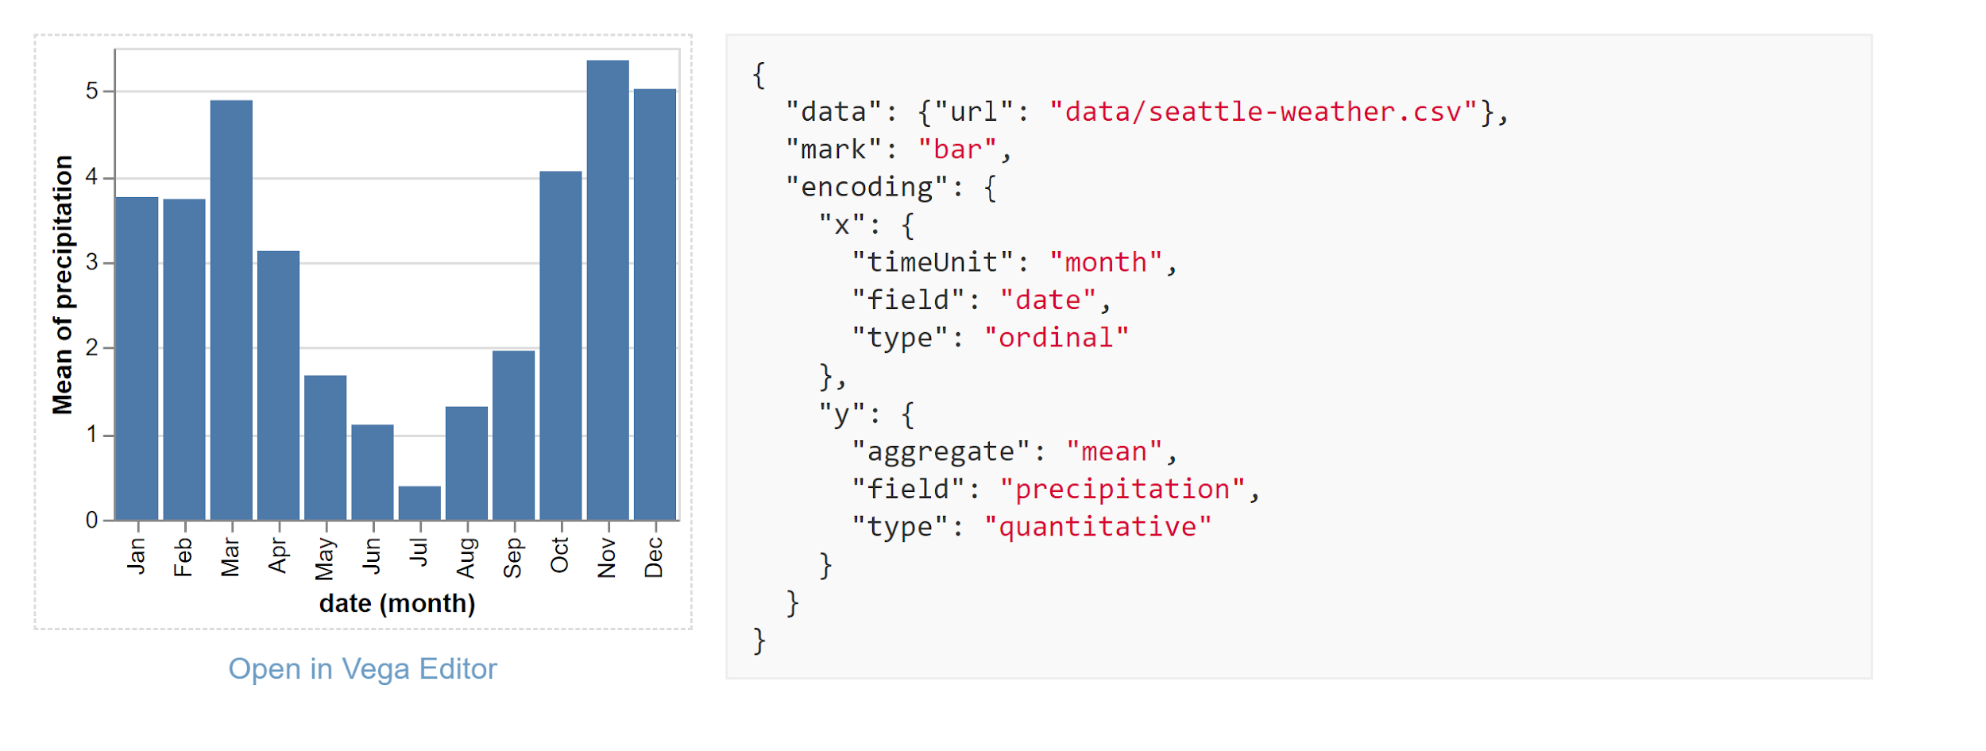
It’s Back
Vega-lite - “ Vega-Lite is a high-level grammar of interactive graphics. It provides a concise JSON syntax for rapidly generating visualizations ...”
https://vega.github.io/vega-lite/

Slide 30
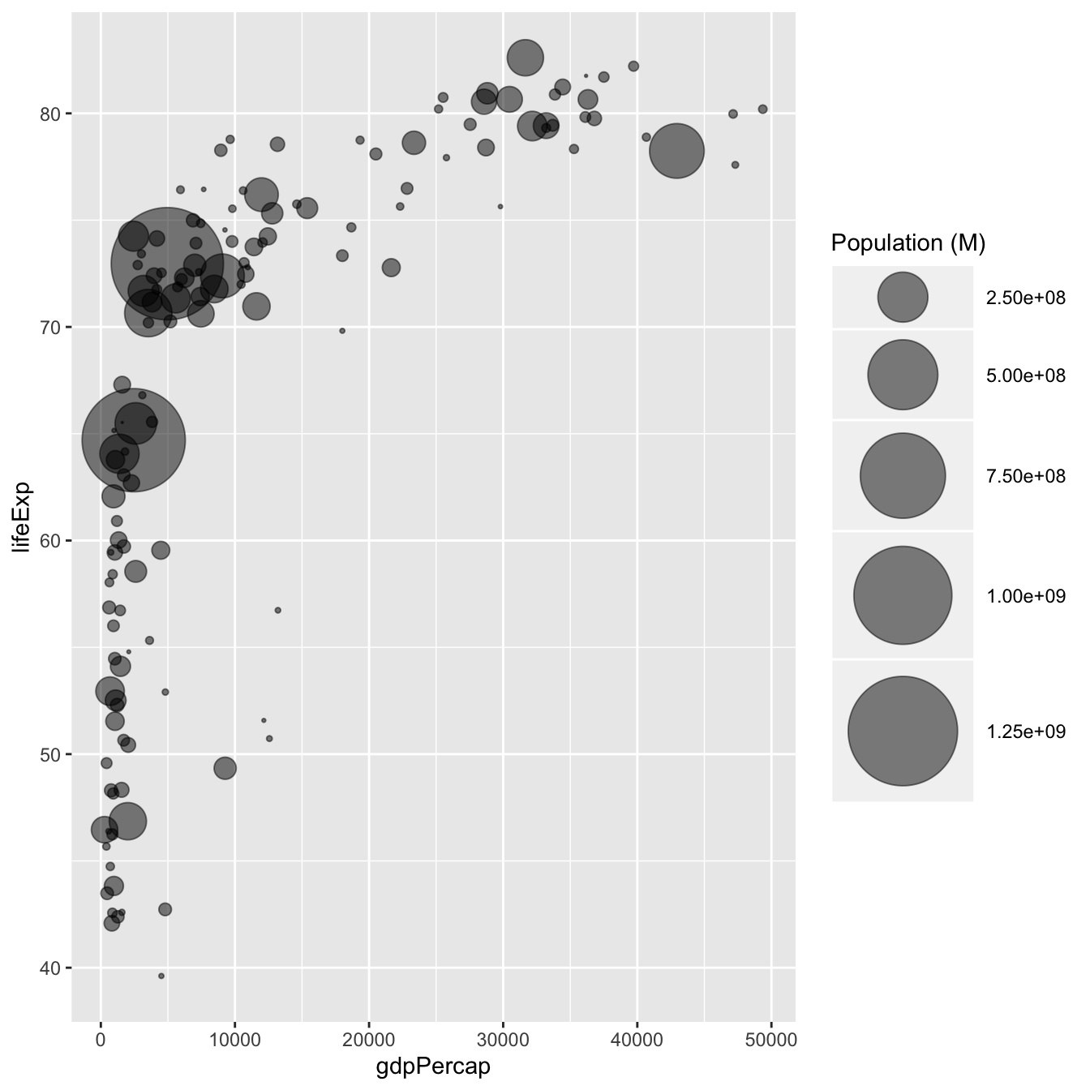
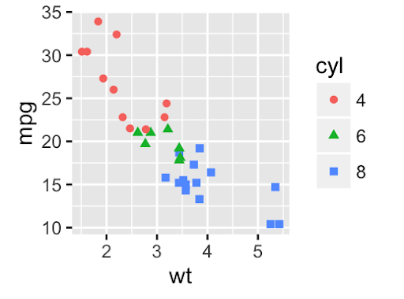
Mackinlay APT: Background/Overview
APT: “A Presentation tool”
Mackinlay APT has an algebra that goes through and generates encodings which then picks a most effective subset of visualizations
Size
Shape and Color
VS.

Slide 31
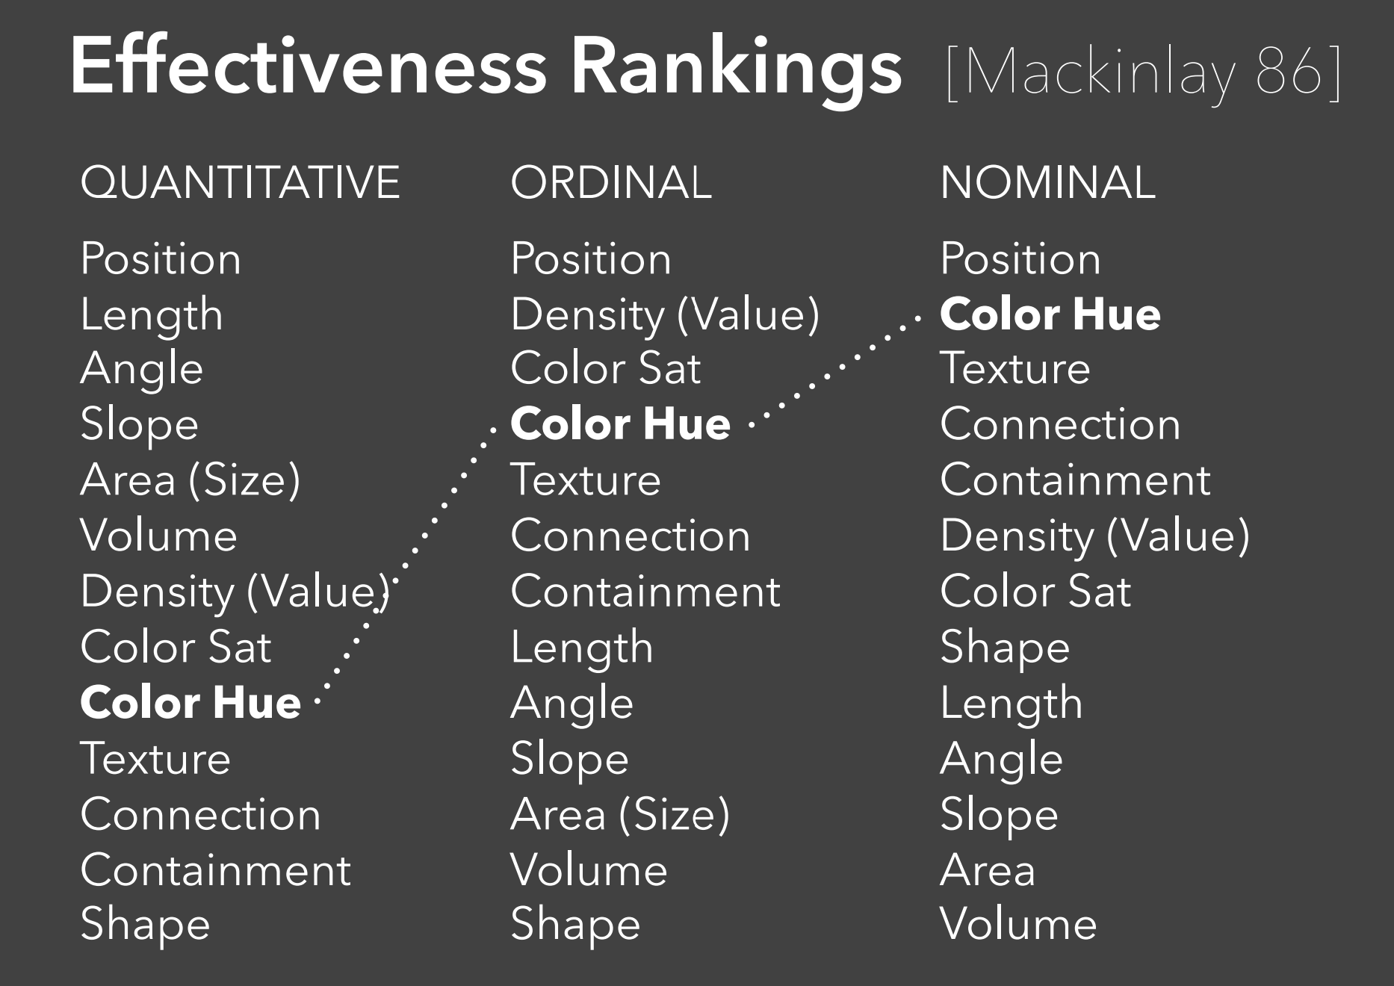
Mackinlay APT:
Design criteria:
Expressiveness: Does the visualization “express” all and only facts from the data
Effectiveness: How easy is data from a visual perceived?
https://courses.cs.washington.edu/courses/cse442/17au/lectures/CSE442-VisualEncoding.pdf

Slide 32
Mackinlay APT: Ranking
APT searches over the design space and tests expressiveness of each visual encoding generated to see if it passes the rank using the effectiveness criteria
Highest Effectiveness is visualization is kept

Slide 33
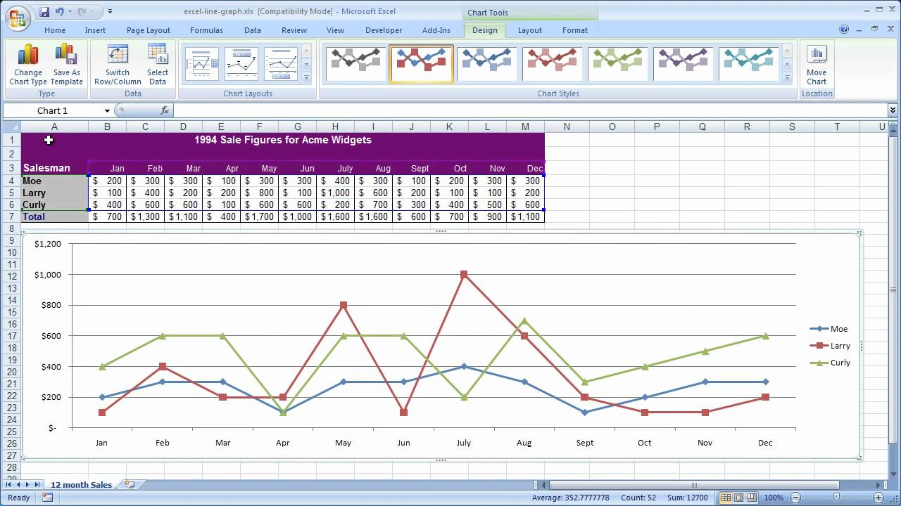
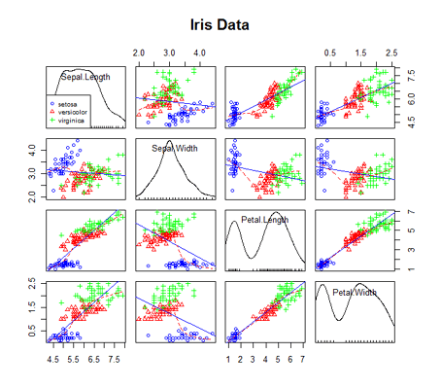
Expressiveness is a Range!
Cartographies - Excel ( limited range
of charts and there is little support of
value refinement )
vs.
Programming languages - R
(Multiple charts, and multiple ways to
manipulate data)

Slide 34
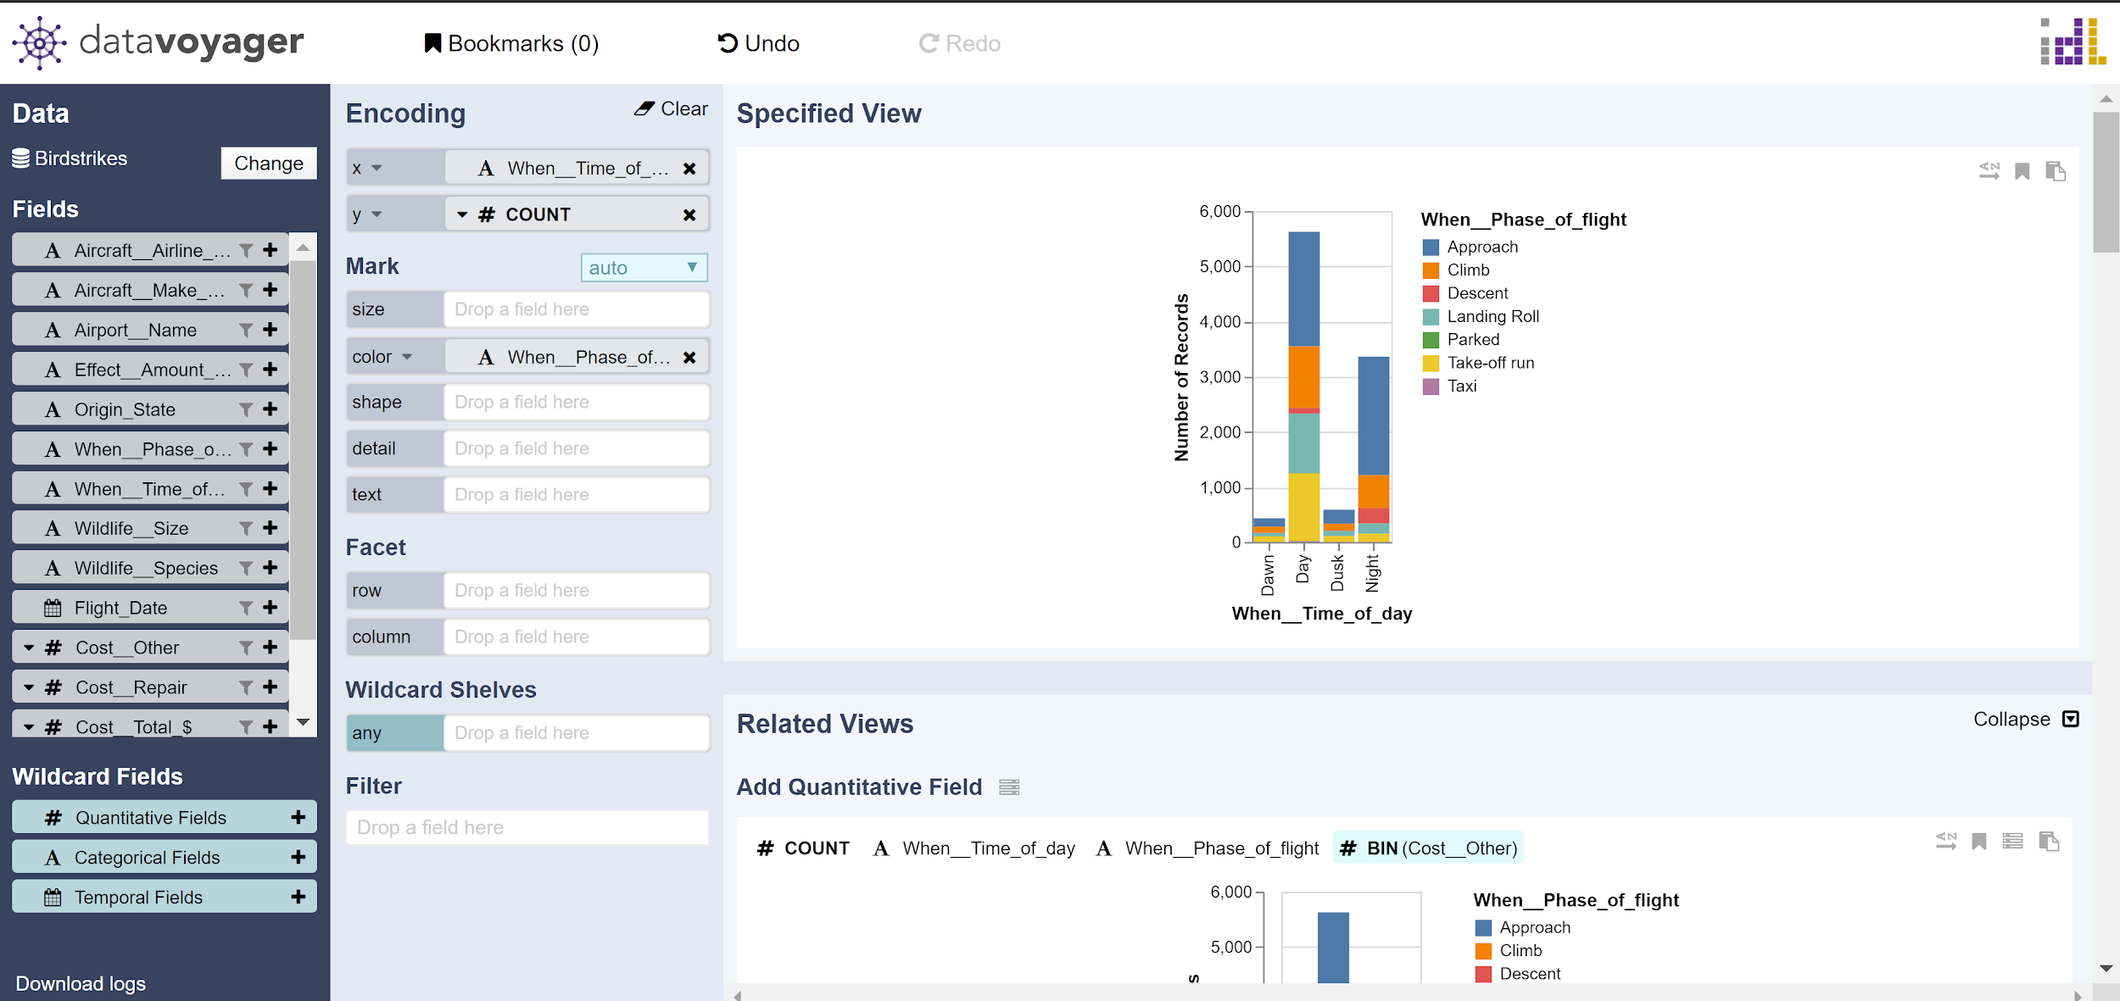
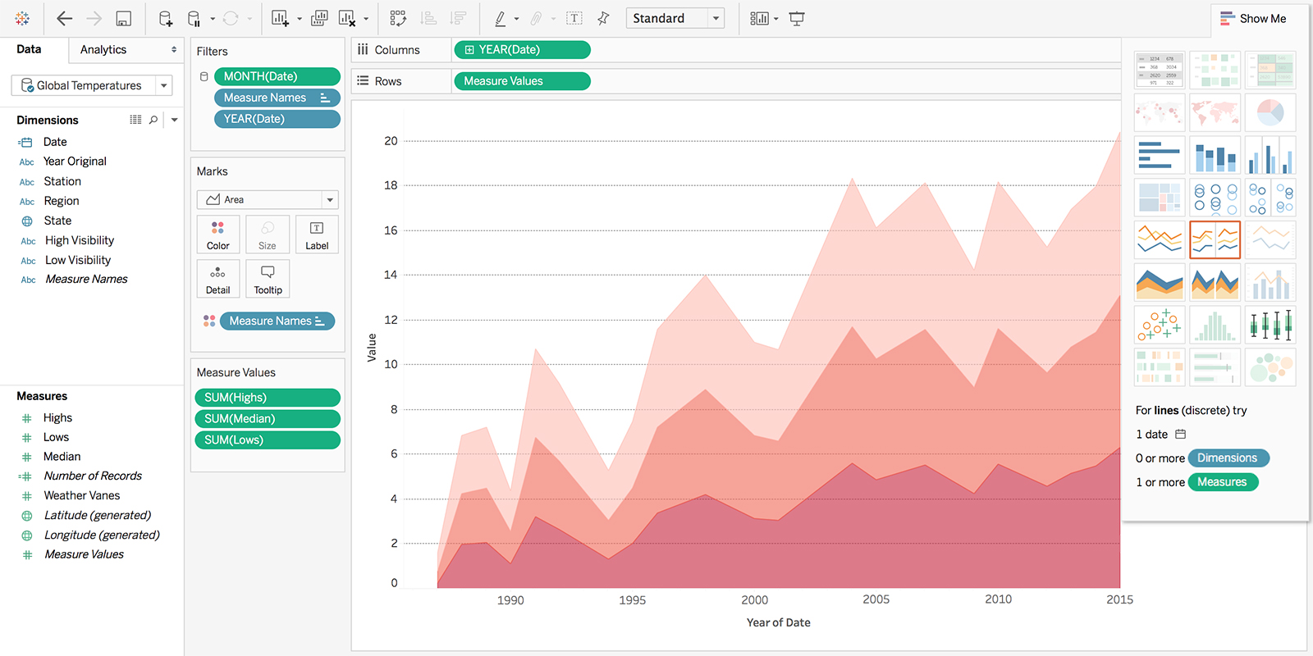
Seems Familiar
Like Tableau but with its own grammar.

Slide 35
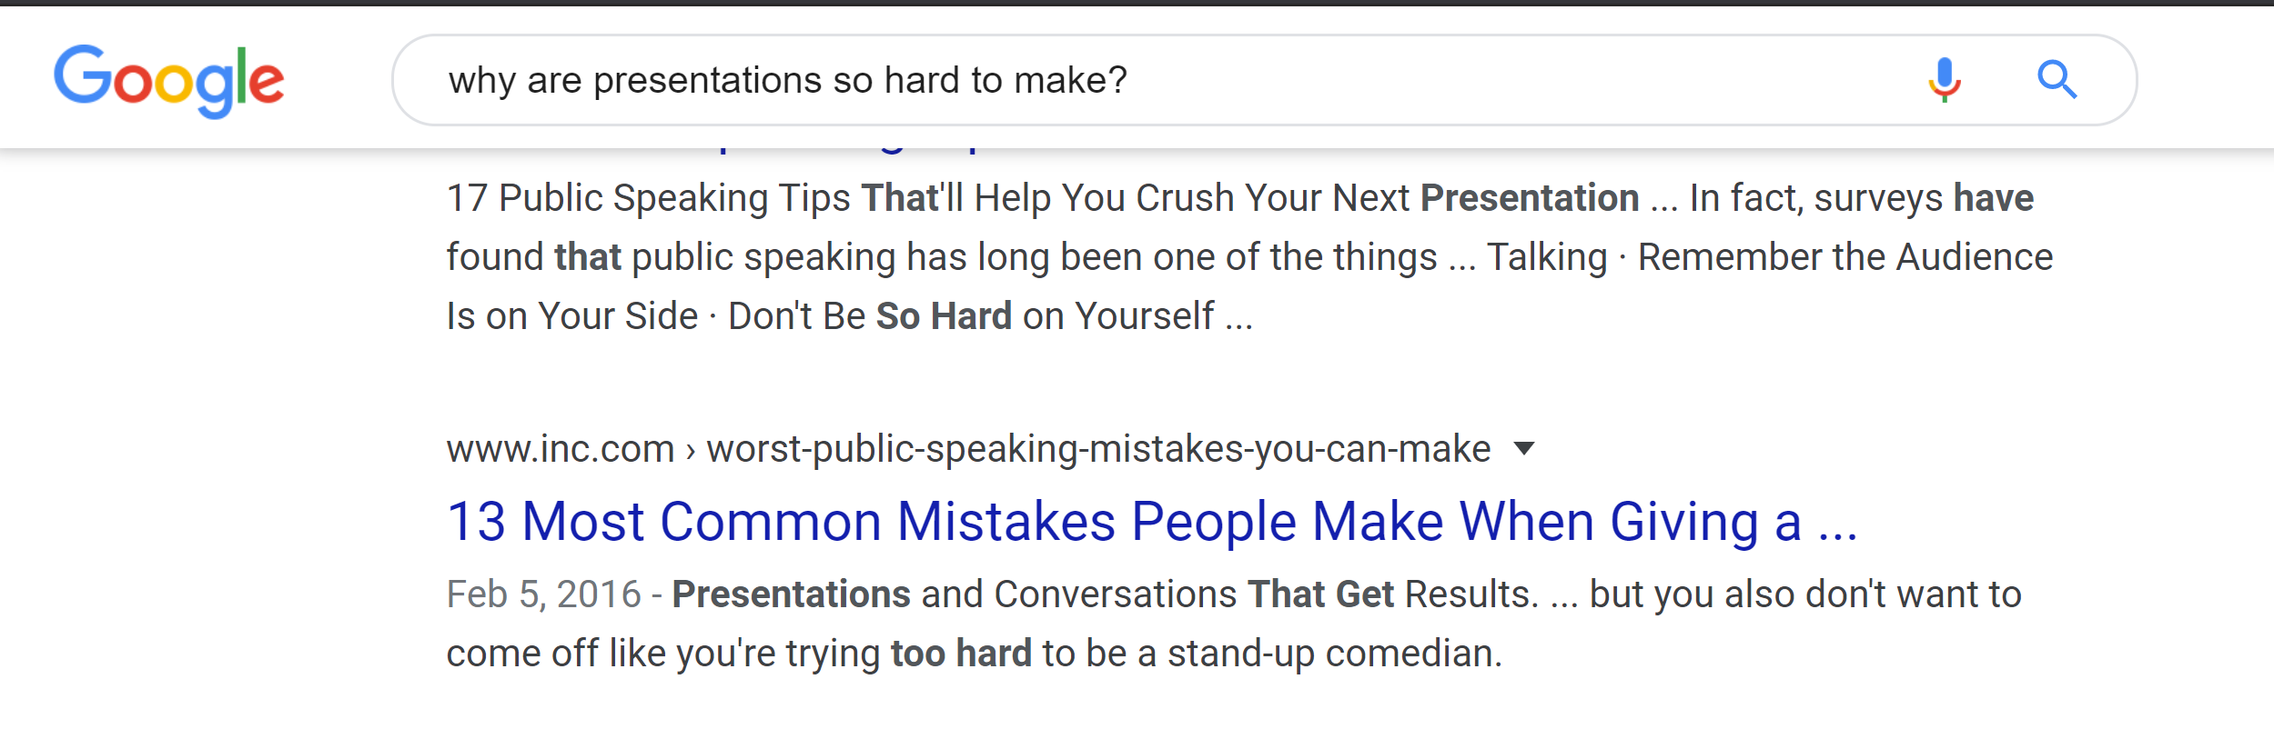
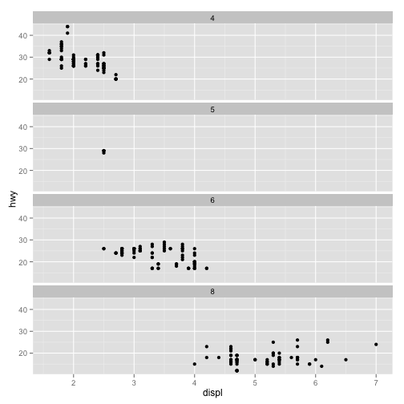
Its All About Browsing
Supports faceted browsing
Exchanges specifications for browsing (exchanges saying what you exactly want and adjusting with exploration)
More coverage/exploration and like tableau exploration

Slide 36
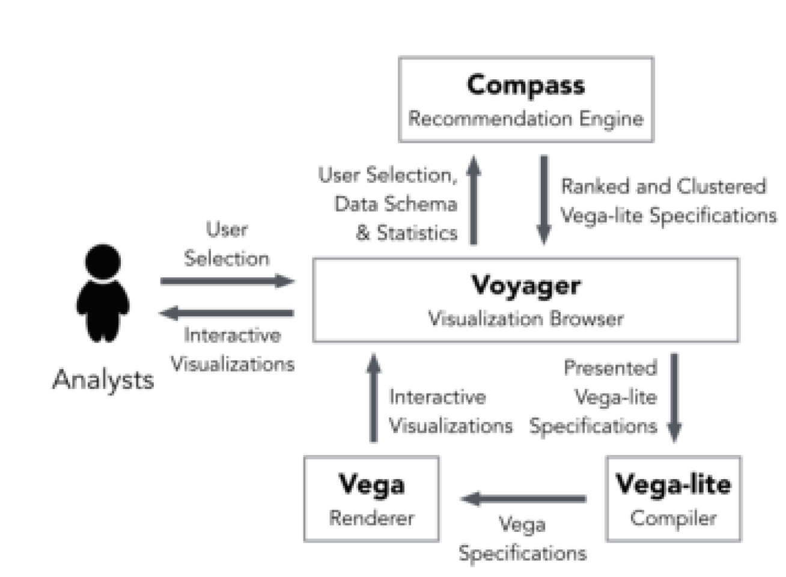
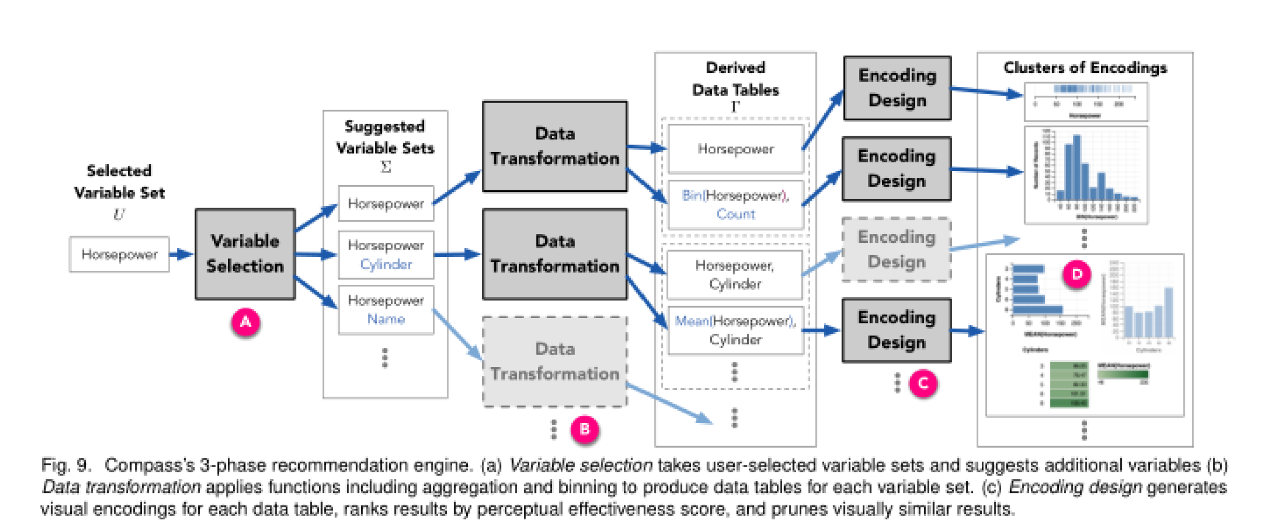
Compass Recommendations
Enumerate, ranks, and prune recommendations
Take user variable set and recommend more variables
Then apply data transformations (aggregation, binning
Design encodings based on ranks
Prune similar ones)
Selecting Recommended variables

Slide 37




Selecting Variables
U = a varble set selected by the user (of size k
D = Data schema’s selection of variable set
V = U ⋃ (an extra variable from the set n)
n= | D - U| = number of all variables not used
Compass returns Σ = [U, v₁, v₂, …, v_{n}]

Slide 38
Translation
Compass returns a set, containing a variable set, that the user picked from the data schema
As well as a copy of that set added with 1 extra variable from the data schema that wasn't part of the original user set.
This is repeated with each variable from the data schema that wasn’t part of the the original user set

Slide 39
Transformations?
Voyager breaks down data
Quantitative = measure
All other data types = domain
Transformations are then done on the data (Aggregation, Binning, sampling, equation transformations)

Slide 40
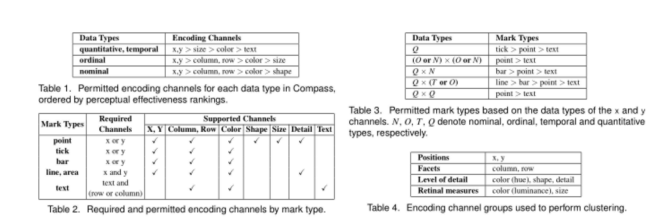
Making the Encodings
Compass generates the permutations of variables, marks, and encodings
Variables assigned permitted encodings called a mapping, which is then combine the valid marks for those mappings
These encodings and marks are then picking by a ranking chart.

Slide 41
Evaluations:
Recommendation Browsing vs. Manual Chart Construction on exploratory analysis on unseen data. The research group made the tool to be the control group.
Sample 16 students with experience using visual tools. Got tool interaction logs, and no eye tracking data.
I would have also made a control tool to compare too, but I would test a mix of non experience users and experience users. If the tool was good for exploring, complete novices speed rate should also be measured and show a significant difference in the ease to use the program and exploration.
Overall from the paper’s testing, Voyager allowed people to explore more and look over 3 times the amount of datasets and was preferred for exploration. Seems to satisfy the researchers’ goal for this paper

Slide 42
Future Work:
The Paper: Additional interaction techniques besides browsing, interacting with data while browsing. As well as probabilistic ranking models/ personalization relational models.
How about browsing data without any input but just on the fact of finding any patterns in the data?

Slide 43
DISCUSSION

Slide 44
Voyager Discussion

Slide 45
Voyager
Was the evaluation “fair”? What would you have done?

Slide 46
Voyager
Is breadth vs depth the appropriate axis to study?
What are the pros and cons of breadth-oriented exploration?

Slide 47
Voyager
What characteristics should be important in recommendation?

Slide 48
Voyager
What characteristics should be important in recommendation?
Task/user goals (what does the task of exploration mean?)
Directly find “interesting” views
Perceptual appropriateness

